Slide 1

`

Slide 3
Introduction

Slide 4
LINUX
UNIX
UNICS
MULTICS

Slide 5
History of Unix
MULTICS
Started in 1965 by AT&T, GE and MIT
UNICS
Created by Ken Thompson in 1969
UNIX
Written in 100% C language and released in 1973

Slide 6

History of Linux
In 1991, Linus Torvalds, a graduate student form University of Helsinki designed a UNIX like kernel.

Slide 7













Linux Distributions

Slide 8
Features of Linux
Open Source
Free software along with the source code and documentation.
Multitasking
Capable of running multiple applications and process at the same time.
Multi-user
Allows multiple users to login and use the resources at the same time.
.

Slide 9
Features of Linux
Scalability
Same operating system can be used on a desktop to a super computer.
Reliability
Large servers have been successfully being running without a single second of down time.
Security
Inbuilt firewall (iptables) and SELinux

Slide 10
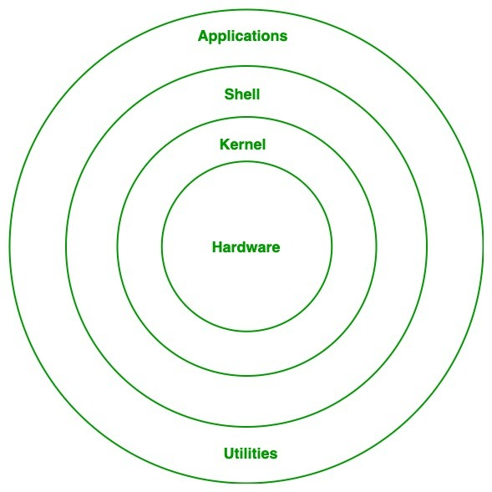
Linux Structure Shell – It read our command verify syntax and check whether the corresponding command related application is available or not. Kernel – It is a interface between shell and hardware, It is responsible to execute our command.

Slide 11
File System Hierarchy Standard
(FHS)

Slide 12
File System Hierarchy
/
root
boot
bin
var
etc
media
run
home
sbin
usr
dev
opt
mnt

Slide 13
/
This directory is called as the ‘root’ directory.
It is at the top of the file system structure.
All other directories are placed under it.

Slide 14
/root
This is the default home directory of the root.
In Linux / Unix the administrator is called as root.

Slide 15
/home
It contains the home directories of all users (similar to ‘Documents and Setting’ folder in Windows).
When any user logs in the current working directory by default is the users home directory.

Slide 16
/boot
It contains the kernel, which is the core of the operating system.
It also contains the files related for booting the OS such as the boot loader.

Slide 17
/sbin
sbin stands for system binary.
It contains essential system commands which can only be used by the superuser (root).
Example:- fdisk, dump, etc.

Slide 18
/bin
bin stands for binary
It contains essential commands which are used by all users.
Example:- ping, cat, chmod, etc.

Slide 19
/usr
usr stands for Unix system resources
It contains the programs and applications which are available for users (similar to program files in Windows).

Slide 20
/var
var stands for variable
It contains variable information, such as logs and print queues.

Slide 21
/dev
dev stands for device
It contains information about all hardware devices.

Slide 22
/etc
etc stands for et cetera
Contains all the configuration files.

Slide 23
/opt
opt stands for optional
It generally contains the third party software's.
Example:- Open Office, Kaspersky Antivirus etc.

Slide 24
Basic Commands

Slide 25
Print Working Directory
Print the name of the current working directory
[root@comp1 ~]# pwd

Slide 26
List of Files and Directories
To see the list of files and directories
[root@comp1 ~]# ls <options> <arguments>
Options
-l Long list including attributes
-a All files and directories including hidden
-d For a particular file or directory

Slide 27
Creation of Files
In order to create the files we have three different tools or utilities
cat command
touch command
vi/vim editor

Slide 28
Cat (Concatenation) Command
Creating and displaying text files
[root@comp1 ~]# cat <options> <arguments> <filename>
To create a file
[root@comp1 ~]# cat > <filename>
To view the contents of a file
[root@comp1 ~]# cat <filename>

Slide 29
Cat Command
To append or add to an existing file
[root@comp1 ~]# cat >> <filename>
To combine the data of two or more files into a third file
[root@comp1 ~]# cat <first file> <second file> >> <third file>

Slide 30
Touch Command
To create a zero byte file
[root@comp1 ~]# touch <filename>
To create multiple zero byte files
[root@comp1 ~]# touch <first file> <second file> <third file>
To change the time stamp of a file or directory
[root@comp1 ~]# touch <directory or filename>

Slide 31
Vi Editor

Slide 32
Editors
VI editor is a screen-oriented text editor written by Bill Joy in 1976.
This is the most commonly used editor for editing files in Linux.

Slide 33
VI Editor Modes
VI editor has three modes of operations.
Command Mode
Insert Mode
Ex Mode (Extended Command Mode)

Slide 34
To go Insert Mode from Command Mode
i - Inserts the text at the current cursor position
I - Inserts the text in beginning of a line
a - Adds the text after the current cursor position
A - Adds the text at the end of a line

Slide 35
Ex mode
:q - Quit without saving
:q! - Quit forcefully without saving
:w - Write (save)
:wq - Save and quit
:wq! - Save and quit forcefully
:84 - The cursor goes to line 84

Slide 36
Vi Editor
To create file
[root@comp1 ~]# vi <filename>

Slide 37
Creating Directories
To create a directory
[root@comp1 ~]# mkdir <directory name>
To create multiple directories
[root@comp1 ~]# mkdir <first dir> <second dir> <third dir>
To create nested directories
[root@comp1 ~]# mkdir -p <first dir>/<second dir>/<third dir>

Slide 38
Navigation of Directories
To change the directory
[root@comp1 ~]# cd <path of the directory>
To change directory one level back
[root@comp1 ~]# cd ..
To change directory two levels back
[root@comp1 ~]# cd ../..

Slide 39
Help and Command Records
To view the manual page of a command
[root@comp1 ~]# man <command>
To view the commands history
[root@comp1 ~]# history

Slide 40
Copying
To copy a file or directory
[root@comp1 ~]# cp <options> <source file> <destination>
Options
-r Recursive (To copy the directory along with its contents)
-v Verbose
-p Copy with permissions

Slide 41
Moving and Renaming
To move a file or directory to a different location
[root@comp1 ~]# mv <source file or directory> <destination>
Rename a file or directory
[root@comp1 ~]# mv <old name> <new name>

Slide 42
Deleting
To remove or delete an empty directory
[root@comp1 ~]# rmdir <directory name>
To remove or delete a file or directory
[root@comp1 ~]# rm <options> <file or directory name>
Options
-r Recursive (Directory along with contents)
-f Forcefully

Slide 43
Some Other Commands
To check date and time
[root@comp1 ~]# date
To change the date and time
[root@comp1 ~]# date –s “day month date hours min seconds”
To see the calendar
[root@comp1 ~]# cal | less or # cal | more

Slide 44
File Viewing Commands
To view the contents of a file screen-wise
[root@comp1 ~]# less <filename>
To view the top lines of a file
[root@comp1 ~]# head <filename>
[root@comp1 ~]# head <filename>
To view the bottom lines of a file
[root@comp1 ~]# tail <filename>
[root@comp1 ~]# tail <filename>

Slide 45
User Password
Creating or changing a user’s password
[root@comp1 ~]# passwd <username>
To find a user’s password encryption tool
[root@comp1 ~]# passwd -S <username>

Slide 46
THANK YOU!

